Slide 1
AIRLINE FLIGHT BOOKING SYSTEM
Represented by
Shital Pacharane.
T Karishma Reddy.
P Bhavyasri.
Shaik Mahaboob Basha.
Pallavi M S.
UNDER THE GUIDANCE OF:
Shilpa Vaidya

Slide 2
ABSTRACT
OBJECTIVE :
Airline Ticket Booking System contains the details about Flight Availability, Passenger’s Information, Ticket Booking, Ticket Records, Ticket Cancellation etc.
An airline’s inventory contains all flights with their available seats.

Slide 3
MODULES
Passenger Details
Insert Flight Record
Ticket Booking
Ticket Cancellation

Slide 4
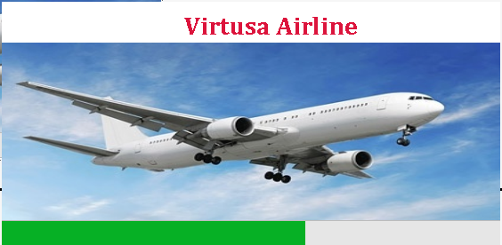
APPLICATION WORK FLOW SCREENSHOTS

Slide 5
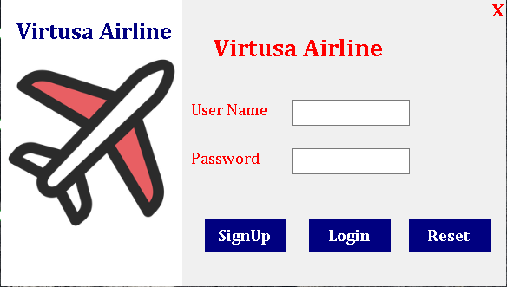
LOGIN PAGE

Slide 6
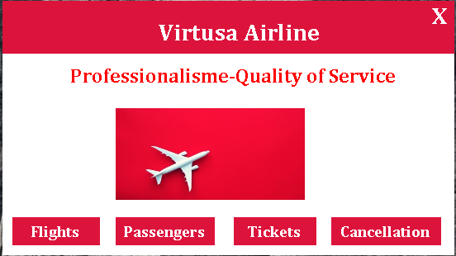
HOME PAGE

Slide 7
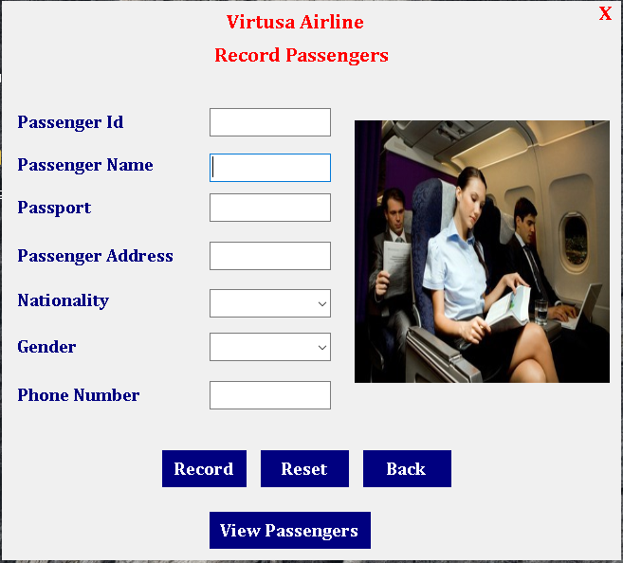
Passengers Records

Slide 8
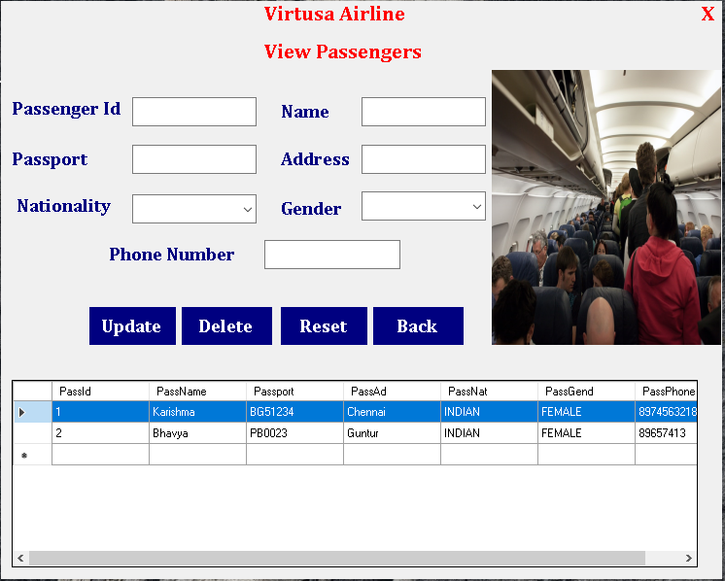
View Passenger
Details

Slide 9
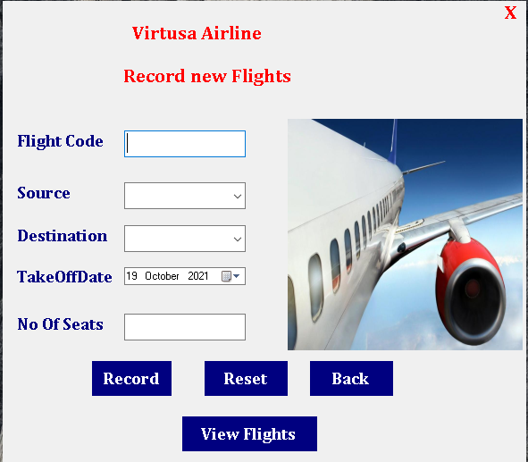
Flight Records

Slide 10
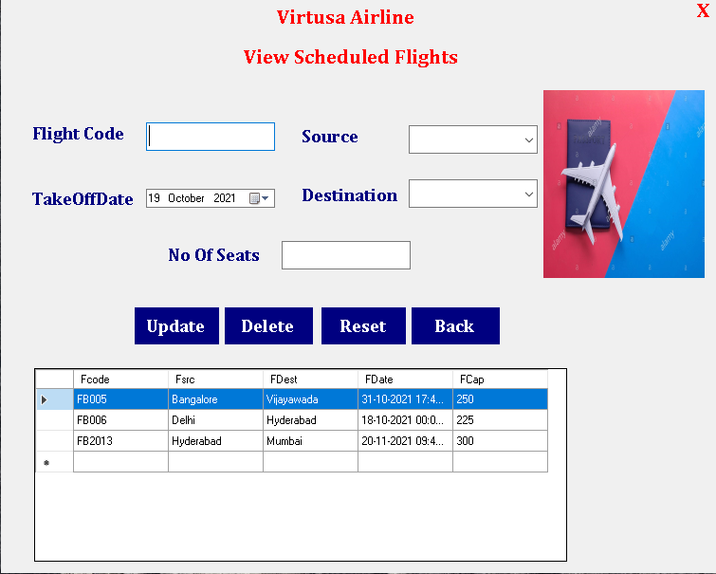
View Scheduled
Flights

Slide 11
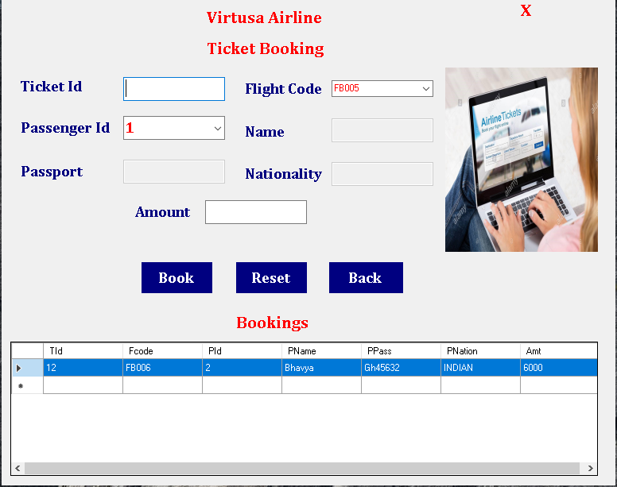
Ticket Booking

Slide 12
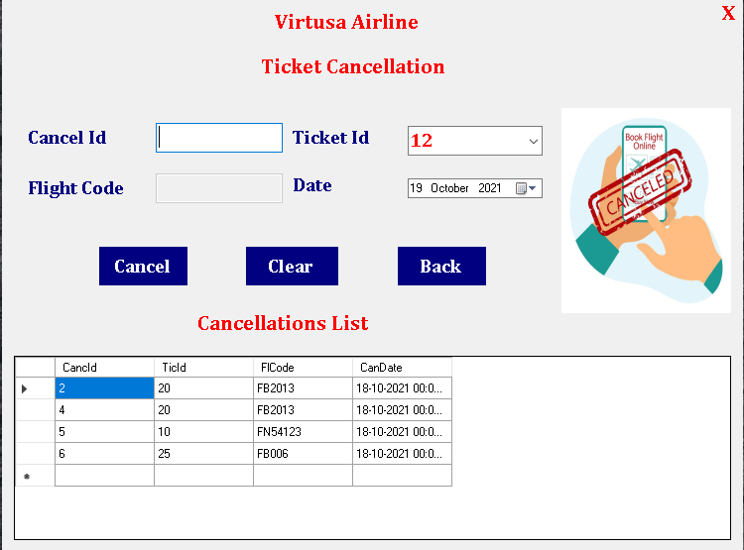
Ticket Cancellation

Slide 13
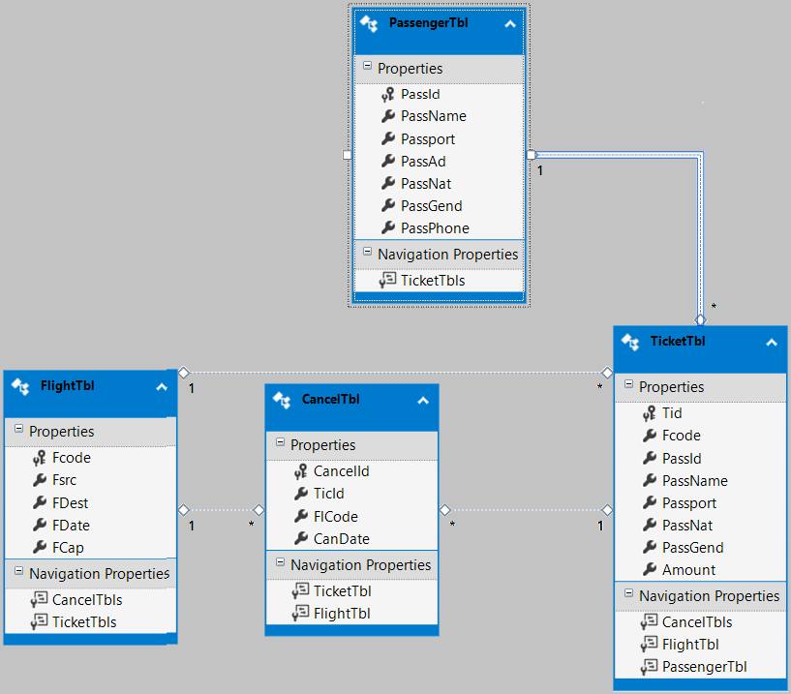
DATABASE ENTITY DIAGRAM

Slide 14



TEAM OVERVIEW
Ms. Shital Pacharane.
Work – Creation of Login, SignUp, Home Page.
Ms. T Karishma Reddy
Work – Recording of Flight Details like Insert, Update, Delete etc.
Ms. P Bhavyasri.
Work – Recording of Passenger details like Insert, Update, Delete .

Slide 15


Mr. Shaik Mahaboob Basha.
Work – Cancellation of Tickets, Cancellation List Display etc.
Ms. Pallavi M S.
Work – Creation of Ticket Booking , Reset , Back.

Slide 16
CONCLUSION
Airline Flight Booking system is a online platform, which enable customers to check the availability of tickets and book their tickets.
It makes the customer easy to get ticket online instead of queue up to buy the tickets.

Slide 17
THANK YOU !!!

